Slide 1
Foreign Direct Investment in India Report
By Sakshi Sanjeeva Hegde
UNID: UMIP8273

Slide 2
Introduction and Problem Statement
Introduction
Investment is a game of understanding historic data of investment objects under different events but it is still a game of chances to minimize the risk we apply analytics to find the equilibrium investment.
Problem Statement
To understand the Foreign direct investment in India for the last 17 years from 2000-01 to 2016-17.
The dataset contains sector and financial year-wise data of FDI in India which comprises Sector-wise investment analysis and Year-wise investment analysis.
Find key metrics and factors and show the meaningful relationships between attributes. Do your own research and come up with your findings

Slide 3
Details of dataset and Methodology:
Details of Dataset:
The dataset consist of financial years from 2000-2016 and also have different sectors.
The investment of foreign investors in the sectors of India is in terms of million USD.
Methodology:
Import Data in tableau
Unpivoting data from converting wide format to long format
Cleaning Labels

Slide 4
Methodology and Case study:
Trend of overall foreign direct investment
Top 10 sectors with maximum FDI
Top 10 sectors with minimum FDI
Sectors that reported high growth in FDI in last 5 years
Sectors that reported high decline in FDI in last 5 years
Which sectors has most variation in FDIs
Is there any correlation between these sectors from FDI perspective
Forecast

Slide 5
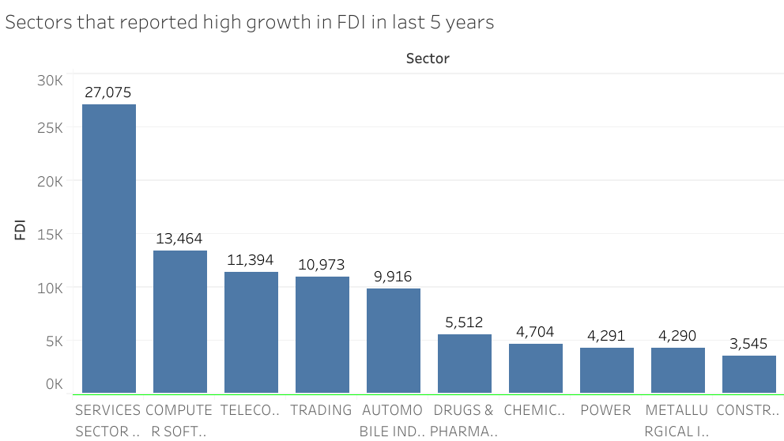
Sectors with high FDI in last 5 years

Slide 6
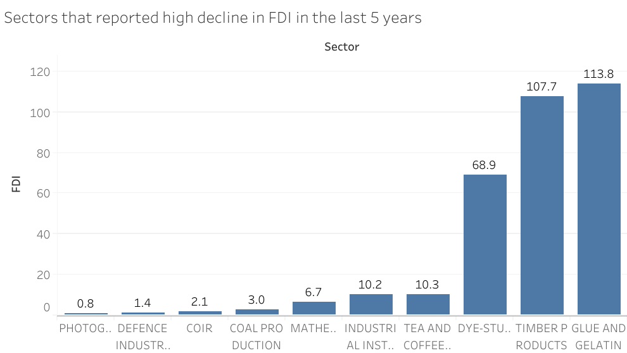
Sectors with low FDI in last 5 years

Slide 7
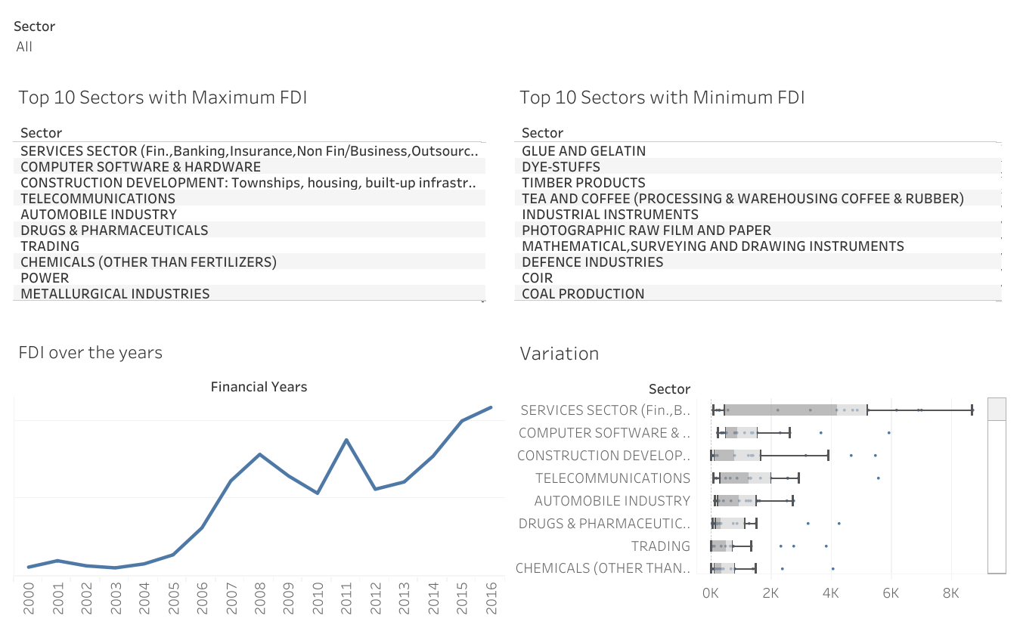
Dashboard - 1:

Slide 8
Findings:
In case of sectors with maximum FDI, the service sector ranks the highest followed by the computer software and hardware and in case of sectors with minimum FDI, the coal production ranks the lowest.
In case of sectors with high FDI in last 5 years (2012-2016), the service sector still have the top spot.
In case of sectors with low FDI in last 5 years (2012-2016), photographic raw film and paper have the lowest spot.
The FDI over the years from 2000 to 2016 shows a positive trend even though there is a drop in 2010 and 2012.
The FDI is increasing since 2012.
The Service sector, followed by computer software and hardware, and construction development, has the most variations.

Slide 9
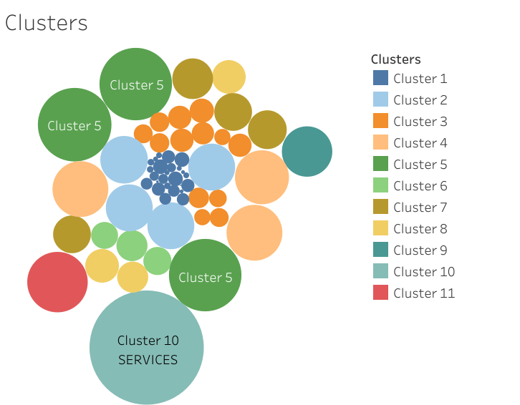
Clusters of different sectors

Slide 10
Findings:
The clusters shows the grouping of different sectors having same range of FDI, which showcase the linear relationship between different features such as
Cluster 1 includes sectors with FDI less than 2k million USD.
Cluster 2 includes sectors (Metallurgical Industries, Miscellaneous Industries, Hotel & Tourism and Construction (Infrastructure) activities.
Cluster 5 includes sectors (Computer Software and Hardware, Telecommunications and Construction development) with FDI having the investment within the range of 23k -24k million USD.

Slide 11
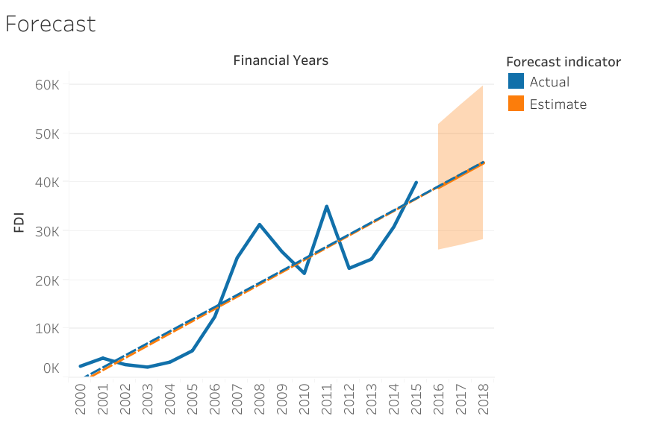
Forecast using the linear trend-line on Tableau

Slide 12
Findings:
The proportion of FDI in Service sector is the highest among different sectors.
Finally, I observed that linear trend fits well with the distribution of the data as it was showing a positive trend. The actual forecast indicator R value is 0.79 and the estimated forecast indicator R value is 1, which shows it is close to 1 of the estimated forecast indicator.
The P - value is less than 0.0001 for both estimated and actual forecast which shows that the model indicates the statistical significance.
So, according to forecasting trend-line, the model predicted the values for 2016, 2017 and 2018 financial years.
For 2016, 2017 and 2018 it is estimated to be 39009, 41517 and 44025 million USD

Slide 13
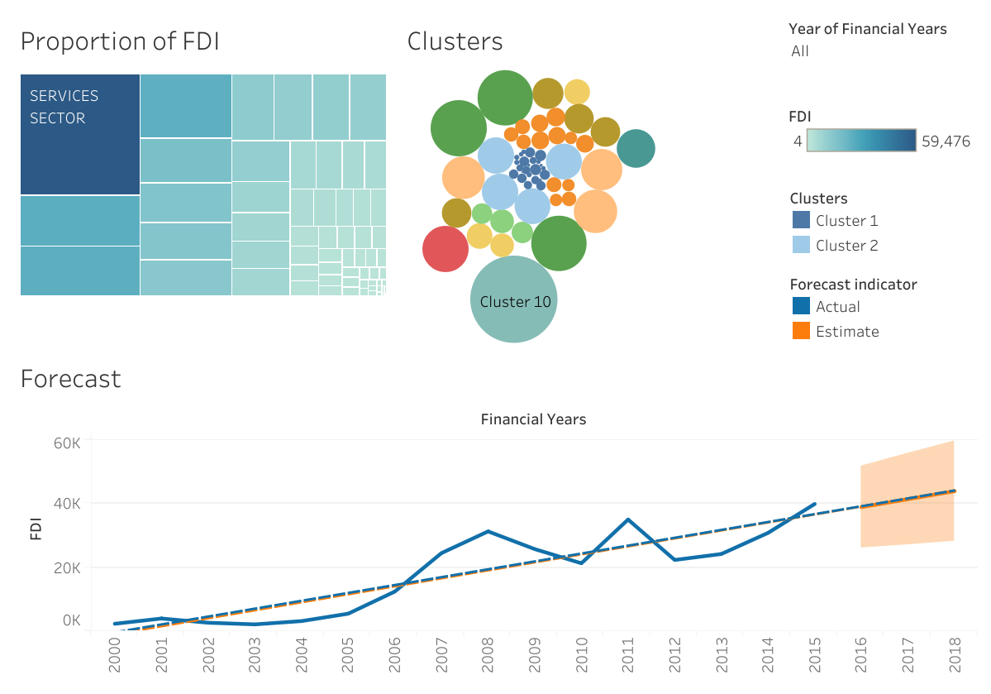
Dashboard - 2:

Slide 14
Thank you

